Slide 1
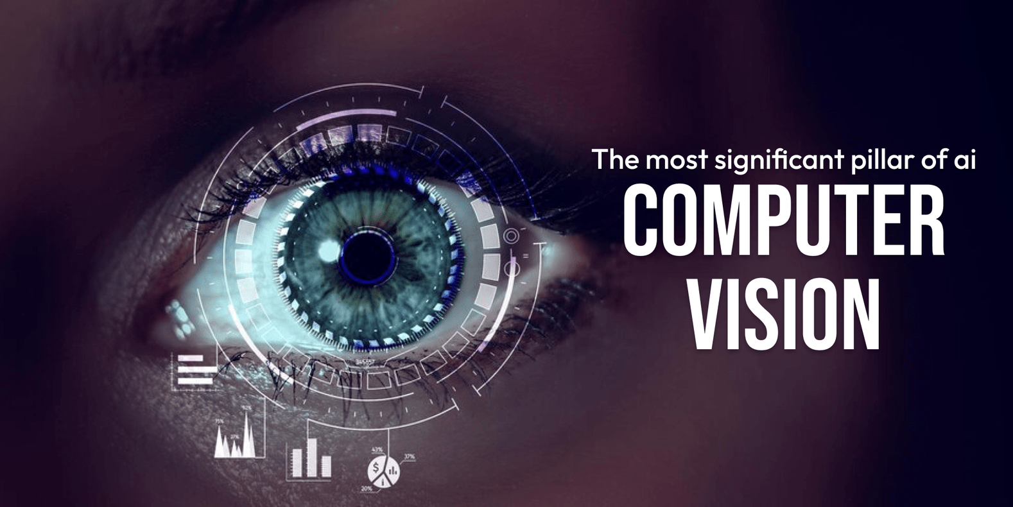
Unit 5

Slide 2
Overview
Why Computer Vision (CV)?
Computer Vision is the process of extracting of information from images, text, videos, etc.,
A system that can process, analyze and make sense of visual data in the same way as humans do.

Slide 3
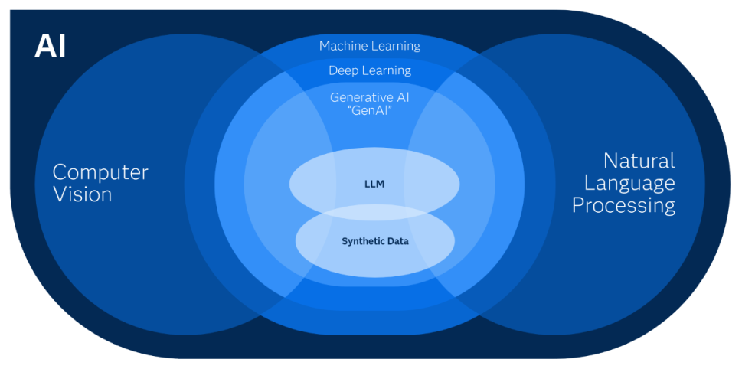
CV & AI
Computer Vision is a subset of AI.
Computer Vision enables AI to see observe and make sense of visual data (such as images & videos)
COMPUTER VISION – CV | IMAGE PROCESSING
Computer Vision involves extracting valuable information from images or videos, analyzing them to gain insights, and using that understanding to make predictions about the visual data. | Image processing primarily focuses on manipulating raw images to improve their quality or prepare them for further tasks.
CV is a superset of image processing | Image process is a subset of CV
Examples: Object Detection, Handwriting Recognition etc., | Example: Rescaling image, Correcting Brightness, Changing tones, etc.,

Slide 4

Applications of CV
Facial Recognition
Face Filters
Google’s Search by Image
CV in Retail
Self-Driving Cars
Medical Imaging
Google Translate App

Slide 5
CV tasks
Computer Vision rely on a set of tasks performed to extract specific information from the input image, which can either be used directly for prediction or serve as a foundation for further analysis.
Single Objects
Classification
Classification + Localization
Multiple Objects
Object Detection
Instance Segmentation

Slide 6

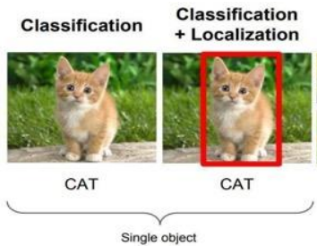
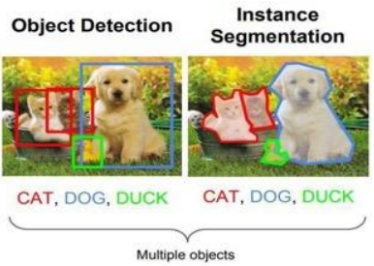
1. Classification
Classification in CV refers to the tasks of identifying and categorizing objects, scenes, or patterns within an image into predefined categories or labels.
2. Classification+ Localization
is a computer vision task where the model not only classifies what object is present in an image but also localizes it by drawing a bounding box around it.
3. Object Detection
Is computer vision task that idenfies what objects are present in an images and where they are located - even when there are multiple objects.
4. Instance Segmentation
Instance segmentation involves detecting objects in an image, assigning them categories, and labeling each pixel that belongs to those objects. The output is a set of segments, each representing a specific object.

Slide 7
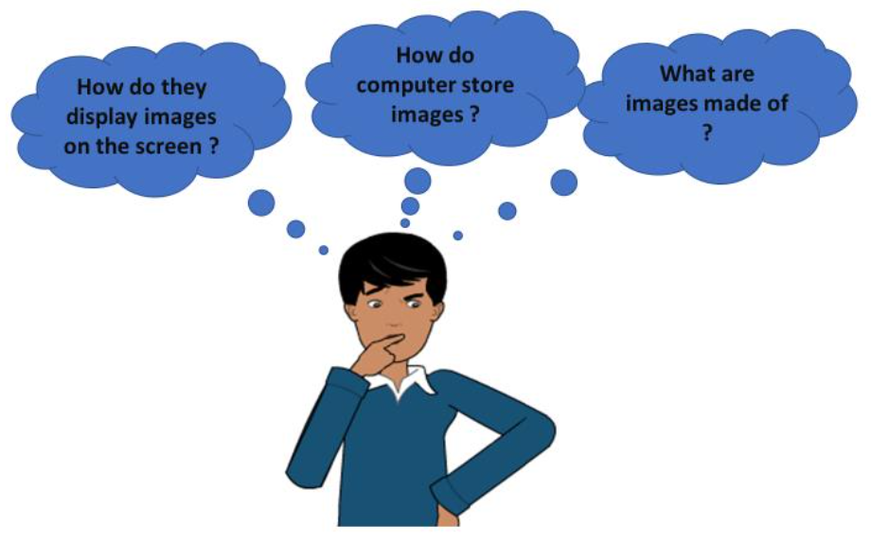
Basics of Images
We all see a lot of images around us and use them daily either through our mobile phones or computer system. But do we ask some basic questions to ourselves while we use them on such a regular basis.
Don’t know the answer yet? Don’t worry, in this section we will study about the basics of an image

Slide 8
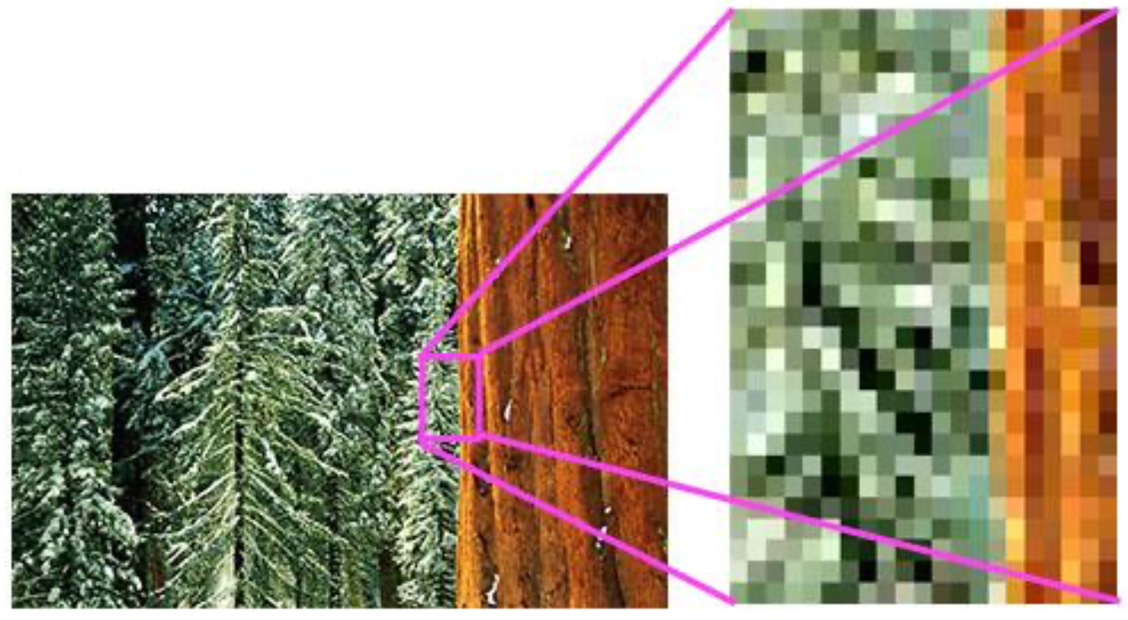
Basics of Pixels
Definition: The word “pixel’ means picture element.
Function: It is the smallest unit of information that forms a digital photograph.
Shape & Arrangement: Pixels are usually round or square and are organized in a 2D grid.
Resolution
Resolution refers to the number of pixels in an image. It can be expressed as width by height (e.g., 1280×1024), or as a single number (e.g., 5 megapixels, where one megapixel equals one million pixels). For example, a 1280×1024 monitor has about 1.31 megapixels (1280 x 1024 = 1,310,720 pixels).

Slide 9
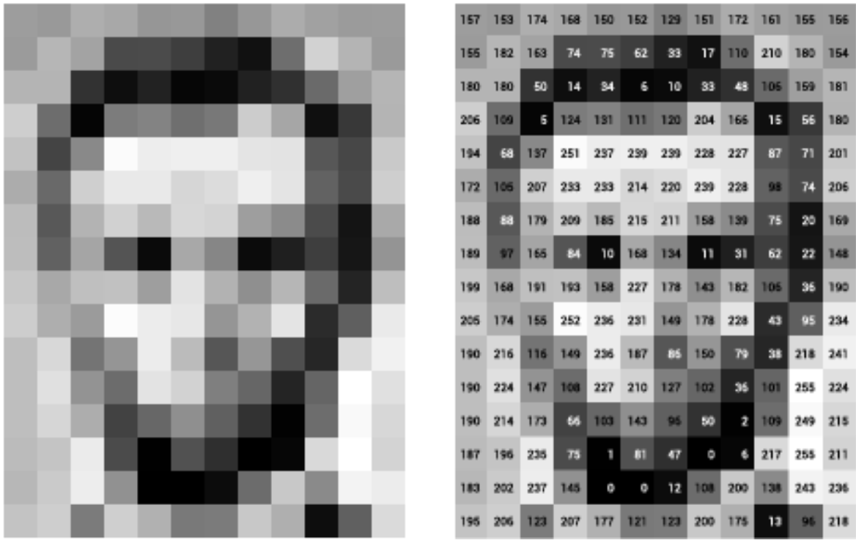
Grey Scale Images
Pixel Values: Every pixel has a specific numerical value that dictates its brightness and color.
The 8-Bit format: In a standard 8-bit image, values range from 0 (pure black) to 255 (pure white)
The binary Math: This scale relies on the binary system. Because each pixel uses 1 byte (8 bits) of data, and each bit is either a 0 or a 1, it yields exactly 256 possible values combinations (0 through 255)
Image Features
Definition: In Computer Vision and image processing, a feature is a piece of information that is useful for completing computational tasks in a specific application.
Structures: These features typically consist of distinct structures within the image such as points, edges, or objects.

Slide 10
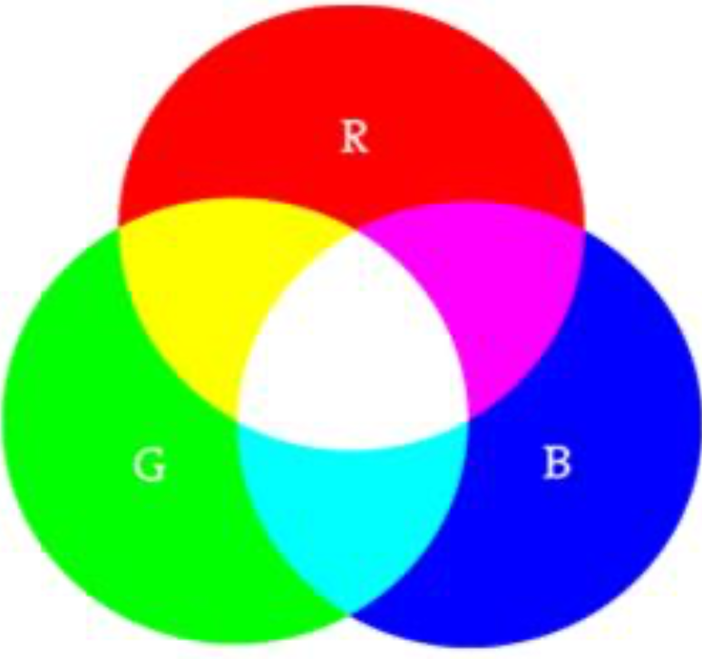
RGB Images
All the images that we see around are colored images. These images are made up of three primary colors Red, Green and Blue. All the colors that are present can be made by combining different intensities of red, green and blue.
Task:
Go to the following link www.piskelapp.com and create your pixel art. Try and make a GIF using the online app for your pixel art.
Let us experience!
Go to this online link https://www.w3schools.com/colors/colors_rgb.asp.

Slide 11
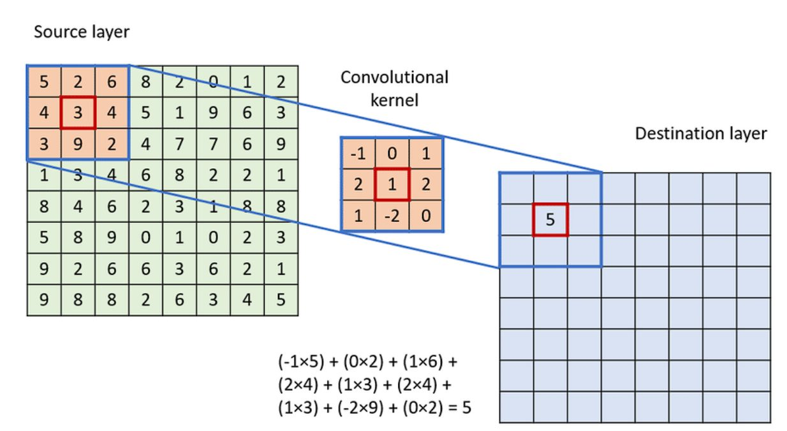
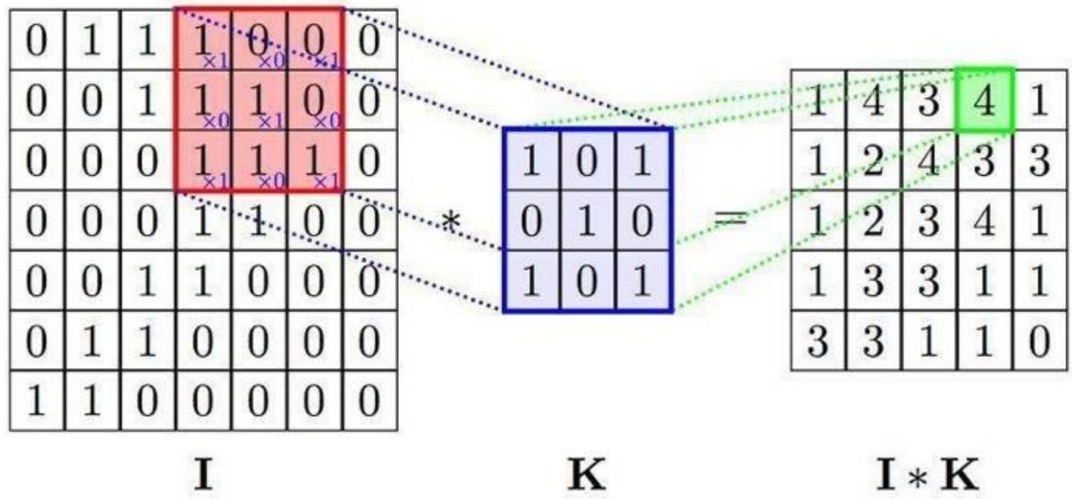
What is Convolution?
Convolution in image processing is a mathematical operation that applies a small matrix, called Kernel or Filter, to an image to create a new one by calculating a weighted sum of the pixels.
Image Array
Kernal Array
Resulting array

Slide 12
What is Kernel?
In image processing, a kernel, also known as a filter or mask, is a small matrix of numbers used to apply effects like blurring, shapening, or edge detection to an image.

Slide 13
What is Convolution Neural Networks (CNN) ?
Introduction
A Convolutional Neural Network (CNN) is a type of deep learning model (algorithm) specifically designed for processing Image data with a grid-like structure, such as images.
In brief:
CNNs use layers with convolution operations to automatically learn features from the input data.
They are especially powerful for tasks like image classification, object detection, and image segmentation.
Key components:
  Convolutional layers: Extract features using filters/kernels.

Slide 14
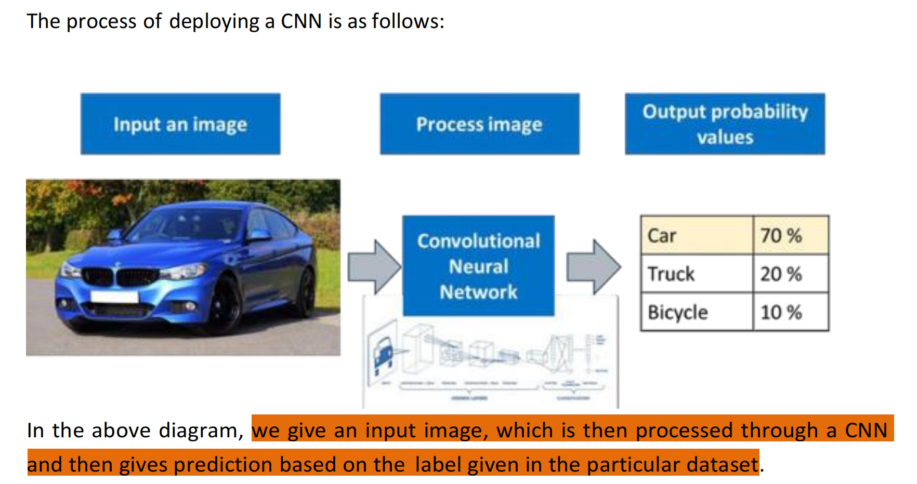

Slide 15
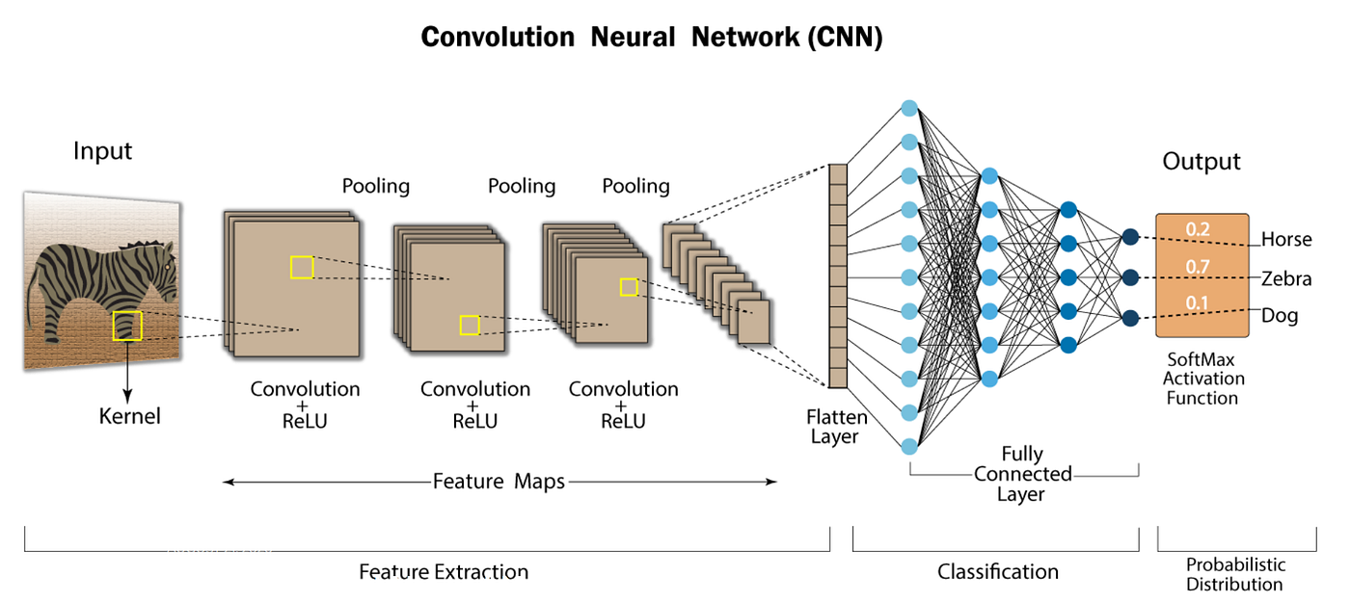
The different layers of a Convolutional Neural Network (CNN) are as follows:

Slide 16
A Convolutional Neural Network of the following layers:
Convolution Layer
Rectified Linear Unit (ReLU)
Pooling Layer
Fully Connected Layer

Slide 17
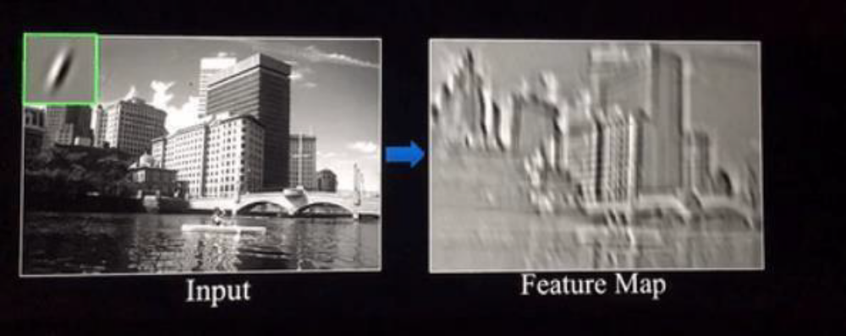
Convolution Layer
It is the first layer of a CNN. The objective is to extract features such as edges, points, lines, objects or textures from the input image. That enables the understanding of the images in the dataset. The output of this layer is called the feature map also known as activation map.
There are several uses we derive from the feature map:
It reduce the images size so that it can be processed more efficiently.
It focuses on the features of the image that can help in processing the image further

Slide 18
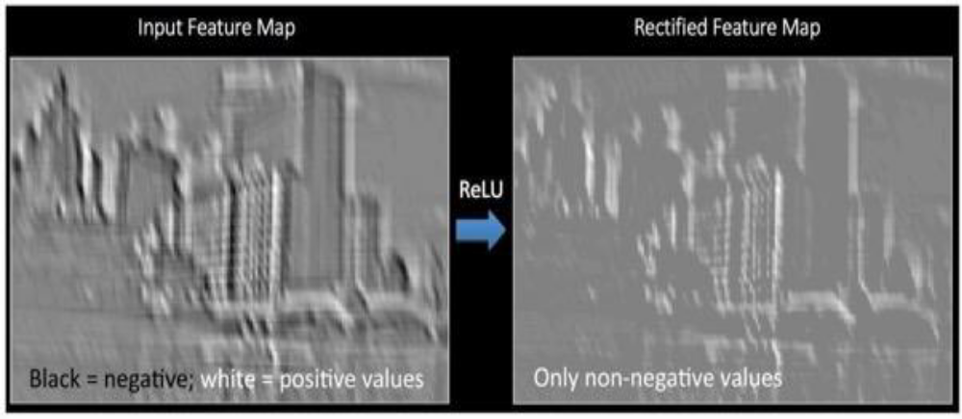
Rectified Linear Unit Layer - ReLU
This layer simply gets rid of all the negative numbers in the features map and lets the positive number stay as it is.
In a CNN, the ReLU function:
Introduces non-linearity so the network can learn complex patterns.

Slide 19
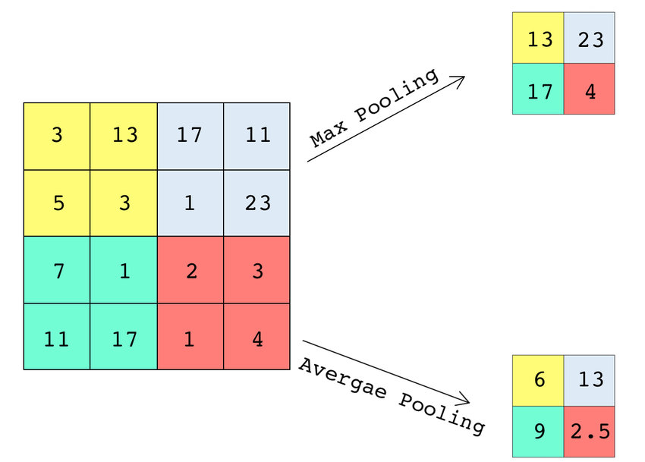
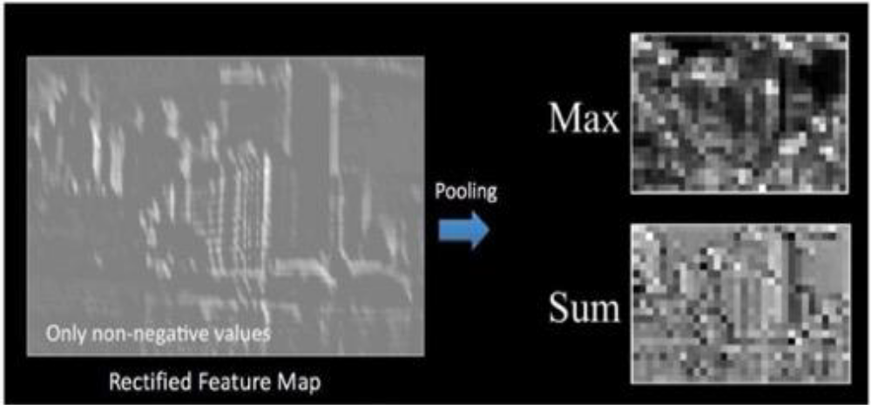
Pooling Layer
In short – Pooling helps summarize features and improve efficiency in CNN.
Makes the image smaller and more manageable
Makes the image more resistant to small transformations, distortions, and translations in the input image.
Common types:
Max pooling: takes the maximum value in each region.
Average pooling: takes the average value in each region

Slide 20
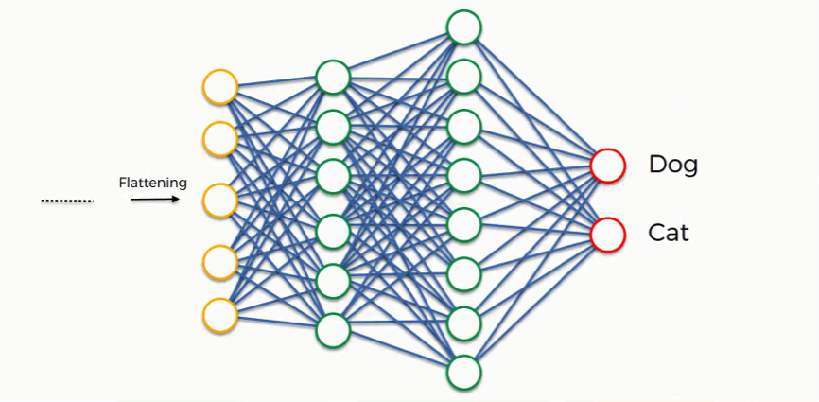
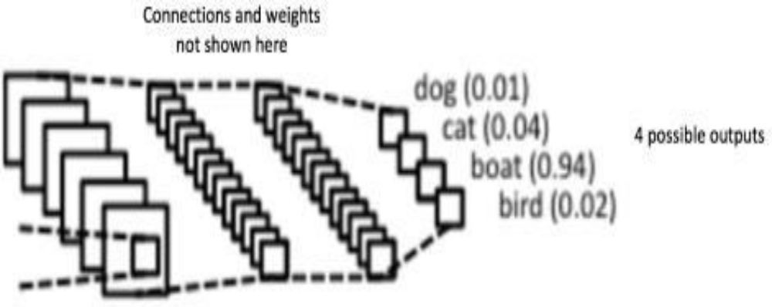
Fully Connected Layer
The objective of a fully connected layer is to take the results of the convolution / pooling process and use them to classify the image into a label (in a simple classification example).
For example, if the image is of a cat, features representing things like whiskers or fur should have high probabilities for the label “Cat”.

Slide 21
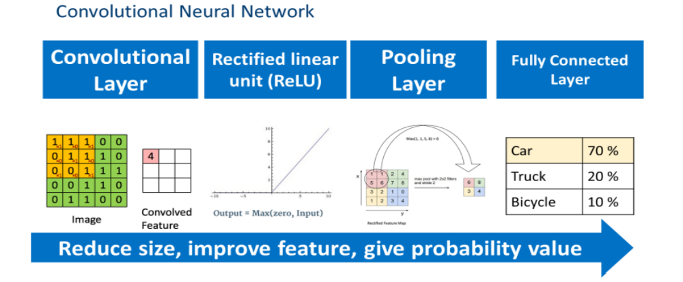
Let’s Summarize:

Slide 22


